Slide 1
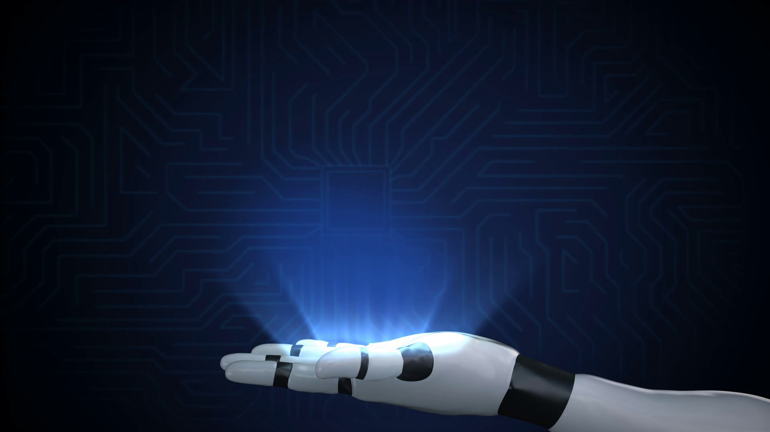

Happy Engineers Day! - Robotics Keynote
www.iot-geeks.org
IoT Geeks
By
Murugadoss Balasubramanian
16/09/2019

Slide 2

Agenda
IoT Geeks
Robotics Overview
Type of Robots
Industries / Applications
Robot Examples
DIY Self-Balancing Robot Hands-on
Q&A

Slide 3
Overview
IoT Geeks
Robotics is an interdisciplinary branch of engineering and science that includes mechanical engineering, electronic engineering, information engineering, computer science, and others. Robotics deals with the design, construction, operation, and use of robots, as well as computer systems for their control, sensory feedback, and information processing (Source Wikipedia)
Robotics is an interdisciplinary branch of engineering and science that includes mechanical engineering, electronic engineering, information engineering, computer science, and others. Robotics deals with the design, construction, operation, and use of robots, as well as computer systems for their control, sensory feedback, and information processing (Source: Roborics.org)

Slide 4
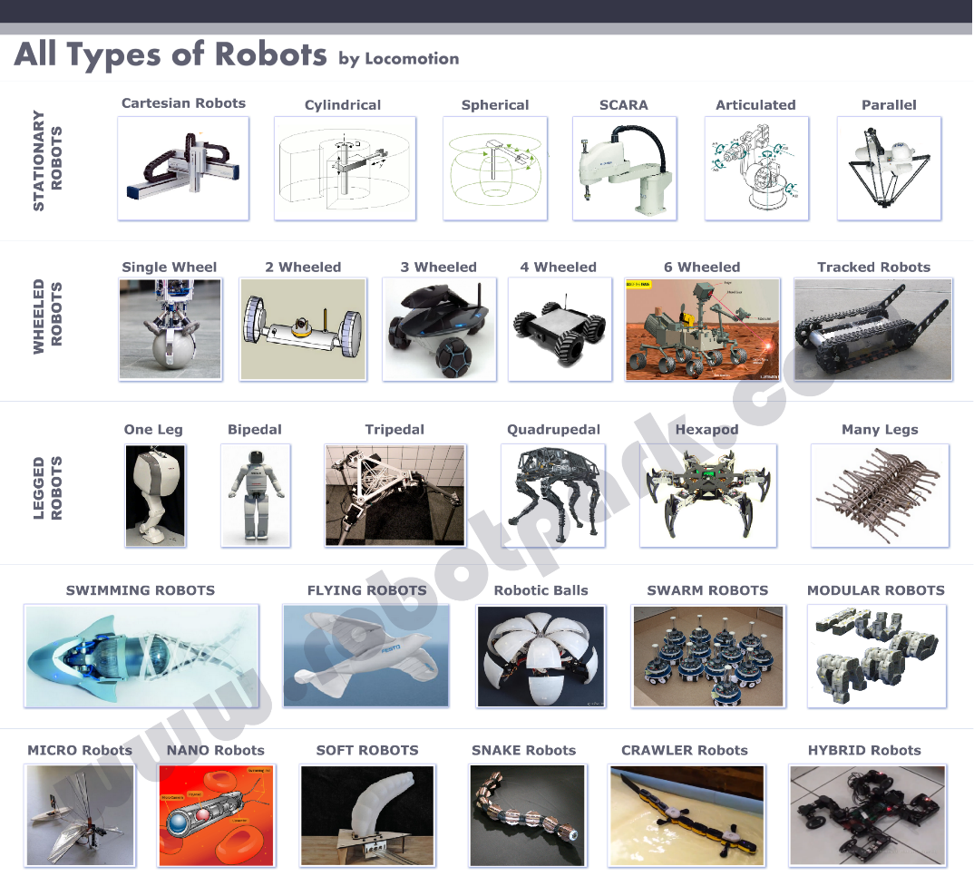
Type of Robots
IoT Geeks

Slide 5
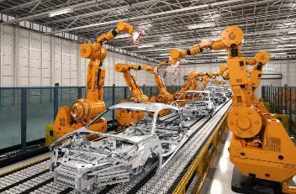
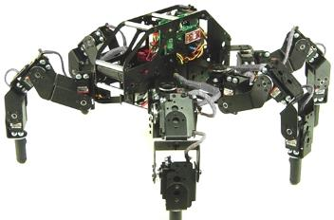
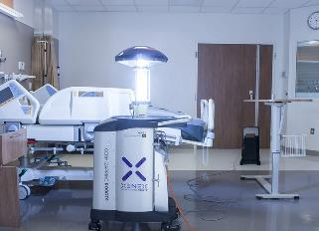
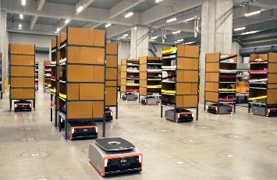
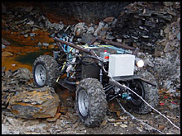
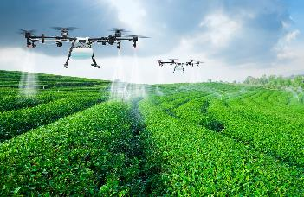
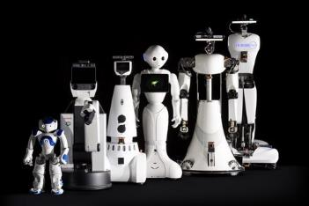
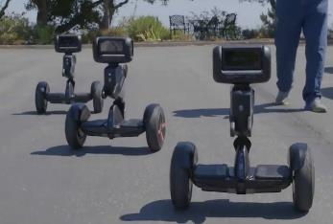
Industries / Applications
IoT Geeks
Automotive / Assembly / Welding
STEAM
Healthcare / Dental
Packaging / Wearhouse
Mining / Construction
Agriculture
Service / Food / Delivery
Security

Slide 6
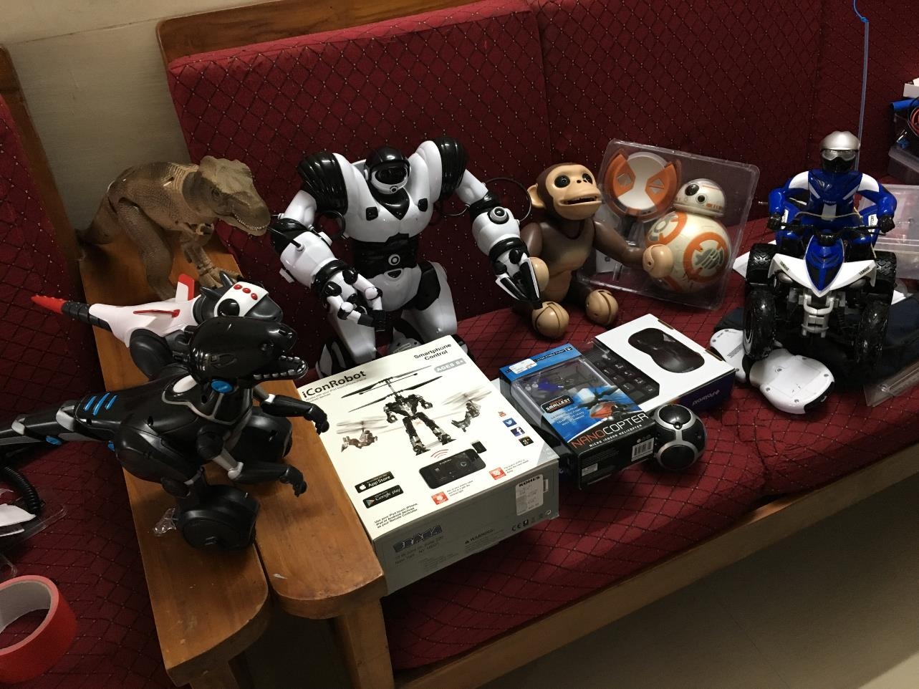
Spot the Self-Balancing Robots
Zoomer Chimp
Robosapien
IoT Geeks
RC CAR
T-Rex Dino
Dragon
MiPosur
BB-8
Nano Copter
Robot

Slide 7
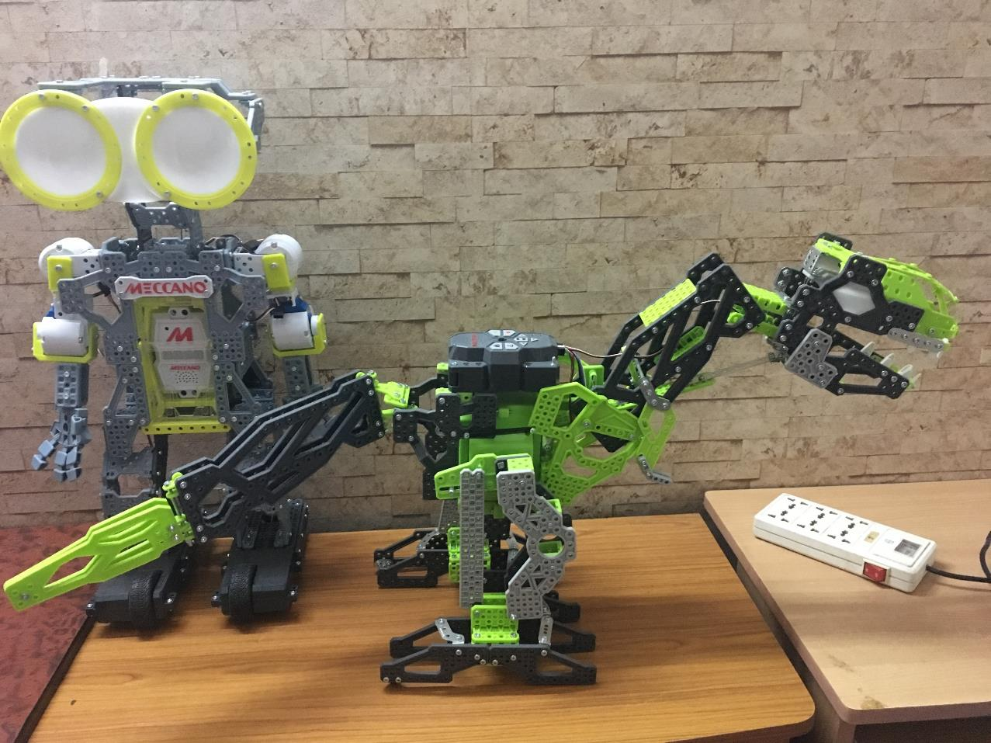
Lego Robots
IoT Geeks
Meccanocar

Slide 8
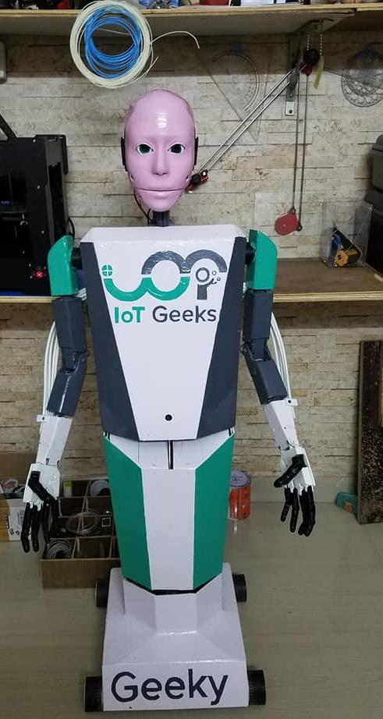
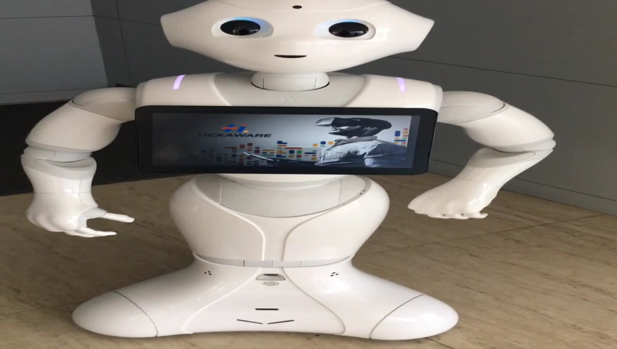
Humanoid
IoT Geeks
Geeky
Pepper

Slide 9
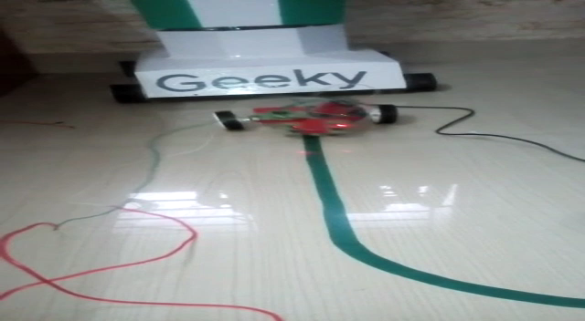
Line Follower
IoT Geeks

Slide 10
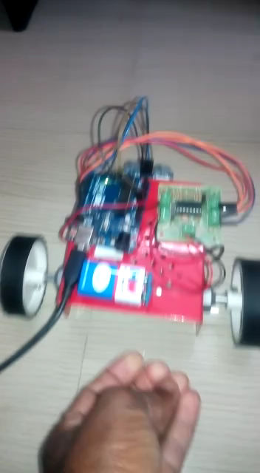
Obstacle Detector
IoT Geeks

Slide 11
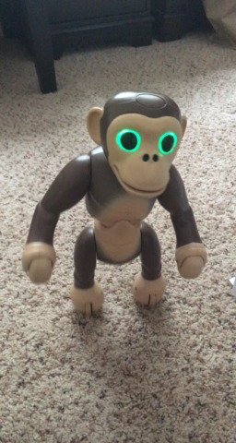
Self-Balancing Chimp
IoT Geeks

Slide 12
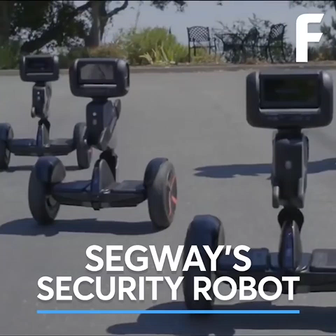
Self-Balancing Autonomous
IoT Geeks

Slide 13
Questions!
IoT Geeks

